Slide 1
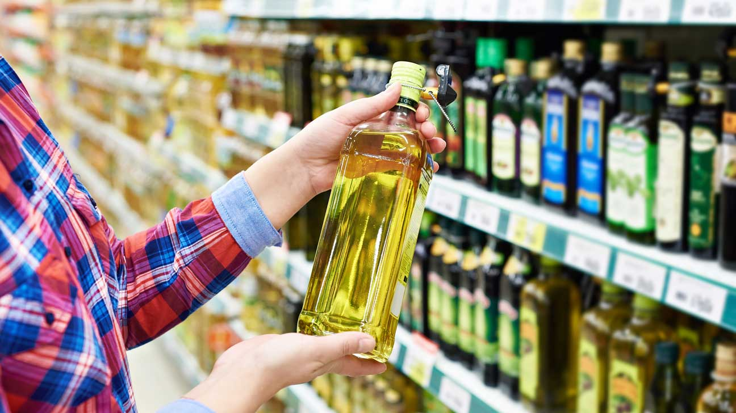
Marketing Study
Cooking Oil
Crystal & Competitors

Slide 2
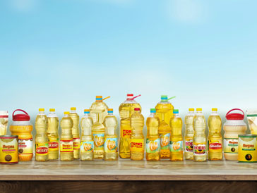
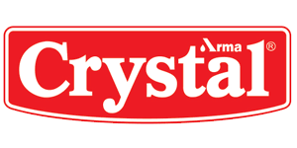
Overview of the Cooking Oil Market in Egypt
There are many different brands available for the consumers in the market.
Our study included several brands like: Afya, Helwa, Slite, Sunny and others.
Their prices range from 30 LE to 100 LE.
They are available in most supermarkets
We evaluated the awareness of the customers of the brands, the brands they usually buy, the important aspects they look for when purchasing oils, whether they would recommend the brand to family or not and their level of satisfaction with the brands performance.
Total survey respondents were 486 persons.

Slide 3
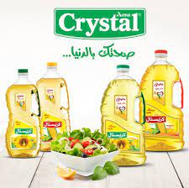
Our Brand: Crystal Oil
The study focused on the performance of crystal oil among competitors and if people would like the two new concepts proposed by the company.
It was the top of mind mentioned.
Customers think it is very good, however it needs to improve in the taste (to be concentrated and not to change with food)
It was chosen as the brand best to use among other brands.
Most customers are satisfied with Crystal’s products.
People look for high taste quality, trusted products.
Also price and offers have an impact on consumers

Slide 4
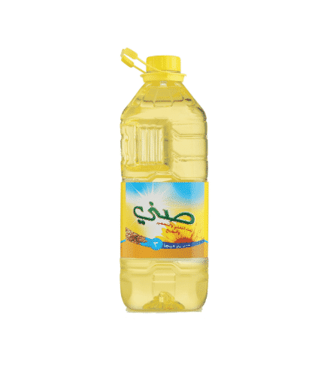
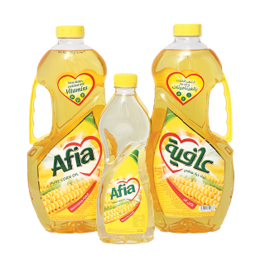
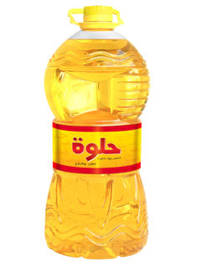
Top Competitors: Helwa – Afia - Sunny
The three brands spontaneously followed Crystal in customers’ awareness of the brand.
Afia was the top mentioned and chosen over Crystal.
Afia followed Crystal in customers’ satisfaction.
Afia’s taste was compared to Crystal’s and it was evaluated as being better than Crystal’s.

Slide 5
Key Findings of the Survey:
The survey focused on brand awareness, which was divided into top of mind (Crystal was the most mentioned), spontaneous (Helwa, Afia and Sunny followed) and aided awareness (Qaleya, Slite and helwa followed)

Slide 6
Key Findings of the Survey:
Brands usually bought where asked to those who are users and aware of the brand, which are 165 persons from the respondents.
The graph below shows the percentage of consumers and their brands usually bought, brand prefer to buy and brand prefer not to buy.

Slide 7
Would Respondents Recommend the brand to their family and friends?
More than 50% said they would recommend Crystal. Only 7% said they wouldn’t. Wadi food and Helwa were the most mentioned brand to be recommended.

Slide 8
Important Aspects for Consumers When Buying An Oil Product:
Product availability, product quality and size are the most important.

Slide 9
Brands’ Performance:
68% are satisfied with Crystal.
69% are satisfied with Helwa, while only 41% are satisfied with Afia and 63% satisfied with Sunny.
People are least not satisfied with Sunny and Afia.

Slide 10
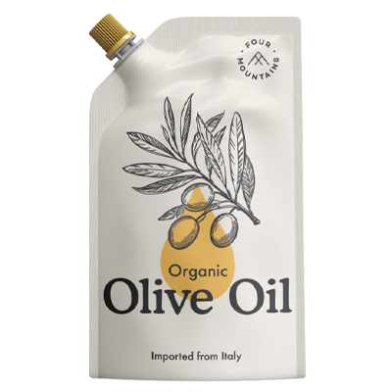
Concept 1: Oil in a bag – Suitable for one time usage
How respondents reacted to this idea?
57% of respondents said they liked it.

Slide 11
Concept 1: Oil in a bag – Suitable for one time usage
Reasons why people liked the idea included: the appropriate price, cheaper, the product’s small size and its one time use.
While those who didn’t like the concept feared the impracticality, leaking, difficulty of usage and difficulty of storage.

Slide 12
Concept 1: Oil in a bag – Suitable for one time usage
Would respondents purchase the product? Would they recommend it to their family and friends?

Slide 13
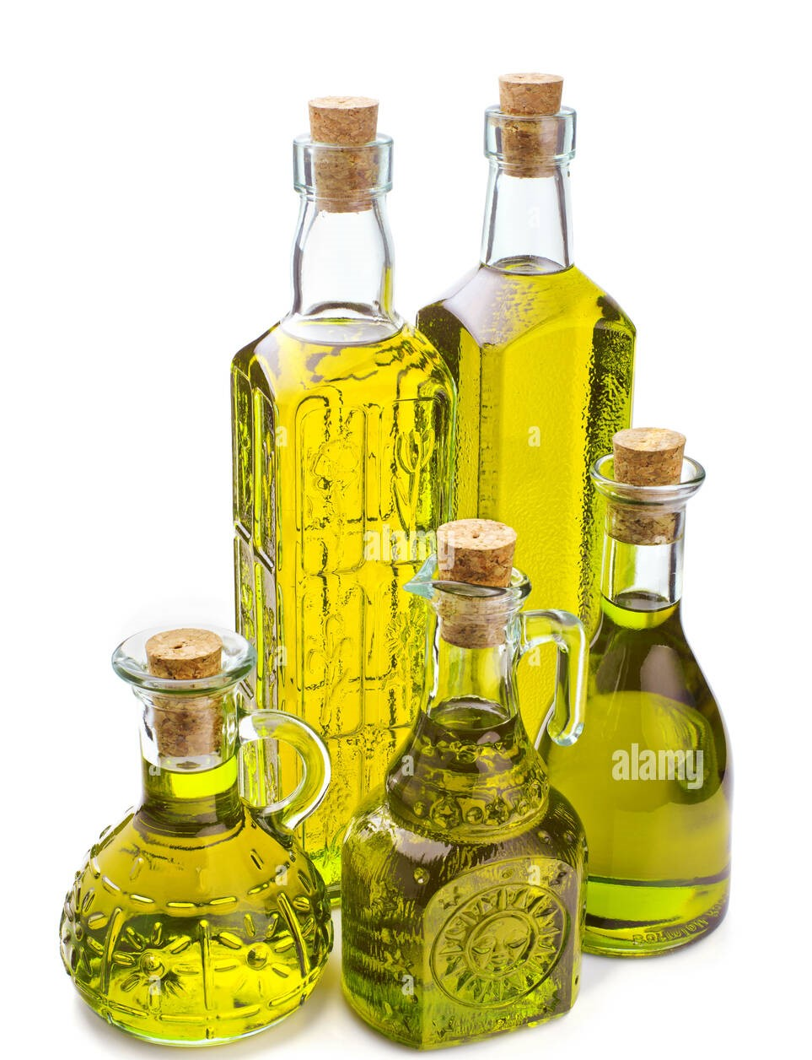
Concept 2: Oil in a Glass Bottle
How respondents reacted to this idea?
84% of respondents said they liked it, while only 7% didn’t like it and 9% were neutral.

Slide 14
Concept 2: Oil in a Glass Bottle
People who didn’t like the concept feared it would be expensive or the glass would be broken
People who liked the concept thought it would be easy to open and close (24%), more healthier packaging (19%), keeps the rest of the oil clean (17%) and having a small package and a cover would be better to 12% and 11% of the respondents.
More reasons for likeability included: suitable price, cheaper, practical, small size and suitable amount.

Slide 15
Concept 2: Oil in a Glass Bottle
Would respondents purchase the product? Would they recommend it to their family and friends?

Slide 16
Reasons to Purchase the two formats:
Price plays an important role for people when purchasing both formats.
Oil in a small bag
Oil in a glass bottle
Price is the only aspect that would influence people’s decision in buying this format. They need the price to be suitable or cheaper than other formats.
Price is a main aspect in people’s decision to purchase this format of the product.
Followed by being healthy, being easy to open and close and having a suitable size

Slide 17
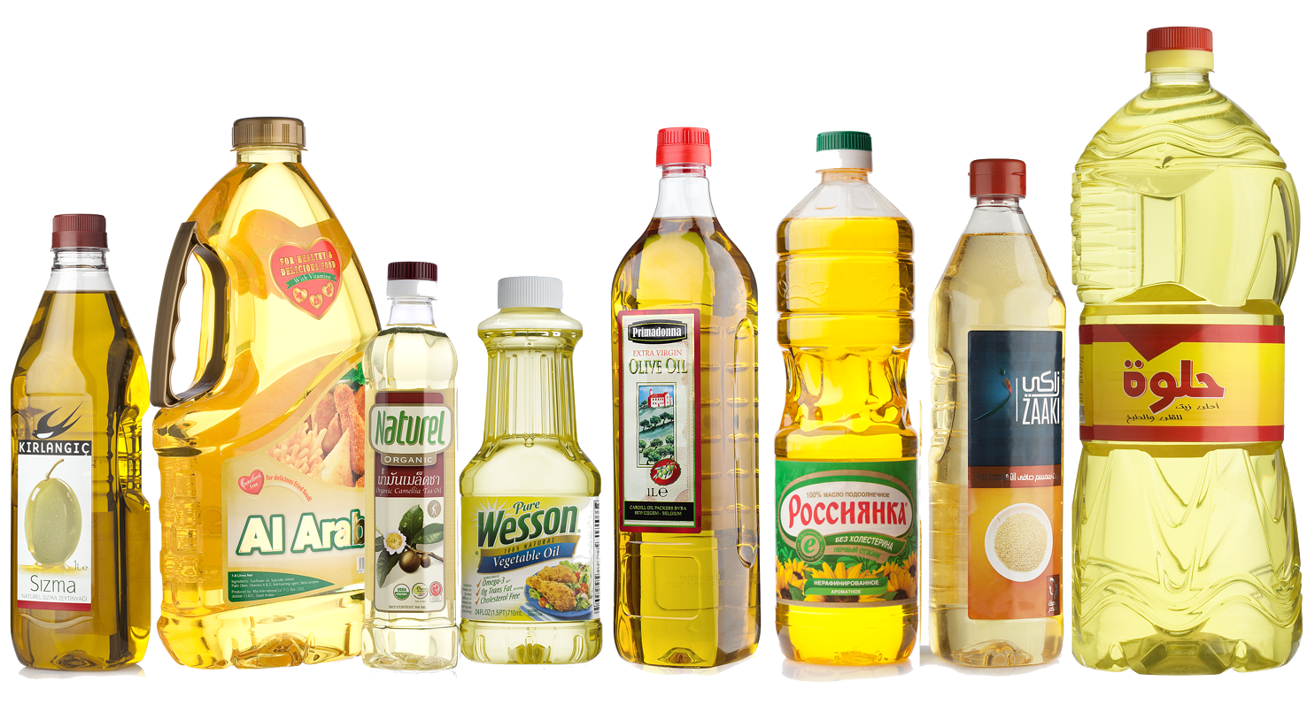
Conclusion:
Concept 2 were more liked by the survey respondents. The company should take into consideration the product’s price point and try to make its price suitable.
More surveys to be followed after the launch of the product in its new format to assess the situation.

Slide 18

Summary
Crystal is top performing among Egyptian consumers.
Concept 2 is more preferable to the consumers.
Consumers give a great importance to the availability of the products in supermarkets.
The quality of the product regarding its concentration, taste, healthiness and having no preservatives are extremely important to consumers.
For Crystal to improve, it has to work on the taste and price. Having offers would encourage people to buy more.
Also, the size of the product is important, the smaller the size, the better to the consumer.

